Slide 1

SharePoint 2019 Upgrade
Michael Wharton
‘mwharton@whartoncomputer.com’
336-972-5741
web site: ‘www.WhartonComputer.com’
Blog: ‘www.MyProjectExpert’
Twitter: @MyProjectExpert

Slide 2












Thank You Sponsors
Platinum Sponsors
Silver Sponsors
Speaker Dinner Sponsor
To all of our sponsors,
Thank you!
Gold Sponsors

Slide 3


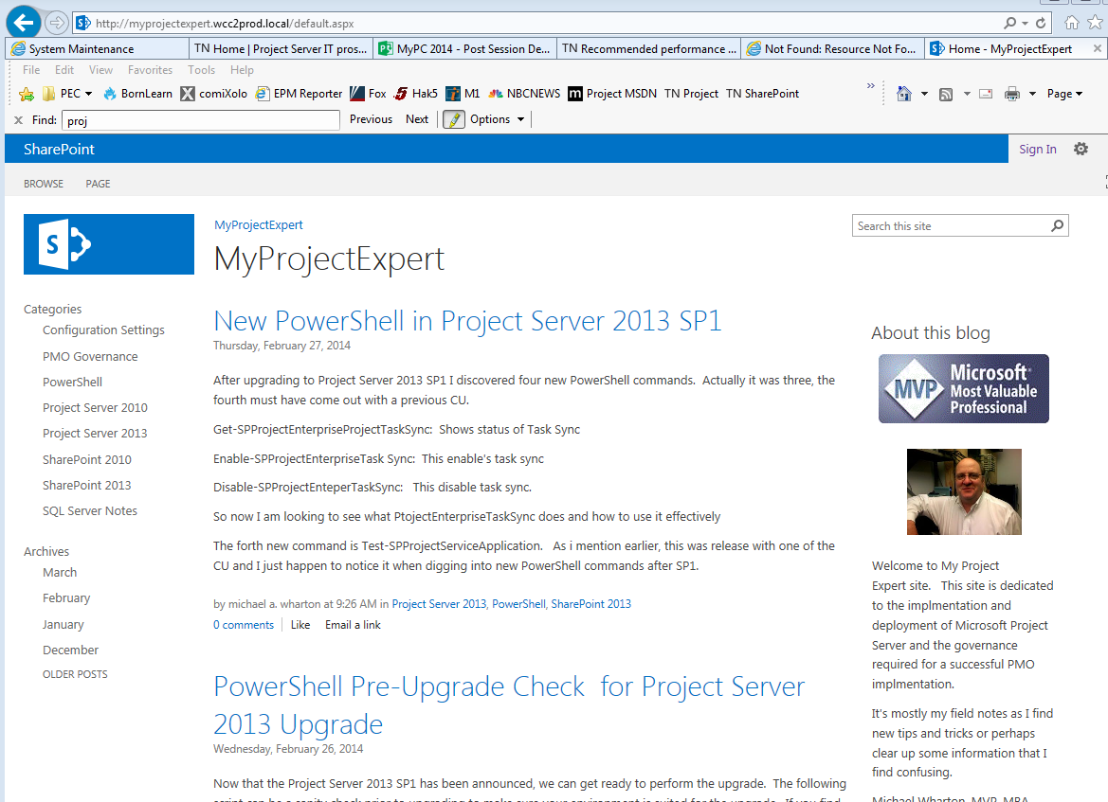



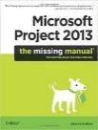
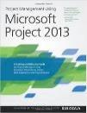

About: Michael Wharton (SharePoint/PMO Consultant)
30+ EPM Deployments 20+ SharePoint Migrations 1000+ Trained Project Manager
PMO Automations and Monitoring
Fundamentals of Scheduling
Microsoft
MVP | MCT | MCTS | MCP+44
Technical Reviewer
Missing Manual: Project 2010 and Project 2013
Project Management using MS Project 2013
Forecast Scheduling 2013
Forecast Scheduling 2018
Forecast Program
7x
Wharton Computer Consulting since 1997
Comic Books
Hardware
Hacking
Robots
Walking
PowerShell
Field Notes
MyProjectExpert.com
Notes:
My passion real passion is automating and monitoring Project Server
My second passion is maintaining good Field Notes!! Using PowerShell
Field Notes
Windows
SQL Server
SharePoint
Project Server
Consistency with Deployments.

Slide 4

Survey
What is role?
SharePoint Admin?
IT Professionals
Consultant / Consulting Firms
Other

Slide 5
Agenda
Envisioning
  Vision / Requirements
  Cleaning up
  Be Familiar with new SharePoint 2019
Planning
  Migration or Upgrade
  SharePoint / Project Server Architect
  Upgrade Path and Strategy
Building
  SharePoint Installation / Upgrade Scripts
  Upgrade Discovery and Issues
Stabilizing
  Finding and fixing SharePoint / Project Server Issues
Deploying
  The final upgrade
Notes:
Enjoy using Project
Have fun working with… make it work for you.. Not against you
When I first started using --- then I started going … this sucks, this sucks and now back to enjoying
Understand how what is going on
Micrsoft Solution Freameowrk

Slide 6

Envisioning

Slide 7
SharePoint 2019 – New Features
Team Site sync is now available
PDF Viewer built in
Recycle Bin restore improvements
Fast site correction
Creating Sites in different web apps
Communication Sites
SharePoint Home
Modern Teams
Modern Lists and Libraries
SharePoint 2019 ships from a SharePoint Online branch
Etc., etc., etc,.
Notes:
SharePoint 2019 – New Features

Slide 8
SharePoint 2019 –Depreciated Features
Depreciated
  Access Services 2010 and 2013
  Aggregated Newsfeed
  Custom help
  Grove Sync Client
  InfoPath Services
  List Web Services
  Machine Translations (and variations)
  Performance Point Services
  SharePoint Designer
  Site Manager
  Site Mailbox
Notes:
SharePoint 2019 - Depreciate

Slide 9
SharePoint 2019 – Removed Features
Removed
  Code Base Sandbox Solution
  Digest Authentication
  Incoming email automatic mode
  Multi-Tenancy
  Power-Pivot Gallery Refresh
  Visio Services – Silverlight based rendering
  SQL Server Reporting Services – SharePoint Integrated Mode
Notes:
SharePoint 2019 - Depreciate

Slide 10
SharePoint 2019 – Architect Changes
Windows Server 2016 or 2019
SQL Server 2016 or 2017
New Workflow Manager
SSRS not in SharePoint Mode (Only Native Mode)
  Migrate and remove SSRS and BI components from 2016 before upgrade
Outbound Email Notifications SMTP
OneDrive Sync Client
More PowerShell Cmdlets
Notes:
Windows Server 2016 or 2019
SQL Server 2016 or 2017
New Workflow Manager
SSRS not in SharePoint Mode (Only Native Mode)
Outbound Email Notifications SMTP
OneDrive Sync Client
More PowerShell Cmdlets
New-SPSite with –CreateFromSiteMaster clause
Set-SPApplicationCredentialKey
Remove-SPApplicationCredentialKey
Get-SpContentDatabaseOrphanedData
Etc., etc.

Slide 11
Envisioning
Office Vision of using SharePoint Server
Mission Statement
Business Objectives
Many Questions that need answers
  Is SharePoint Governance the same?
  How has the Office changed?
  New Features in SharePoint Server change?
  Functionality has changed between versions
Notes:
Enjoy using Project
Have fun working with… make it work for you.. Not against you
When I first started using --- then I started going … this sucks, this sucks and now back to enjoying
Understand how what is going on

Slide 12
Review Any Old/New Requirements
Keeping/Deleting/Archiving
  Completed Project Schedules
  Resource that have left company
  Project Documents and Items
Security/Roles/Permissions
SharePoint Farm and Services
SharePoint / Project Workflow
PMO Process and procedures
Cleaning up *****
Notes:
Keeping/Deleting/Archiving
Completed Project Schedules
Resource that have left company
Project Documents and Items
Security/Roles/Permissions
SharePoint Farm and Services
SharePoint / Project Workflow
PMO Process and procedures

Slide 13

Planning

Slide 14
Which method to follow? Terminology
Migration
Importing content and metadata into SharePoint from any legacy document repository… even if that legacy document repository is SharePoint
Upgrade
The process of updating an existing SharePoint installation to a newer major version
SP2010 to SP2013
SP2013 to SP2016
SP2016 to SP2019

Slide 15
Migration of SharePoint content
The source document repository is not SharePoint
Moving up more than one major SharePoint version (e.g. SP2007 to SP013)
Taxonomy / information architecture needs to be redesigned
Content databases need to be split to improve content database performance or to meet RTO (Recovery Time Objective) or RPO (Recovery Point Objective)
Content is improperly distributed (e.g. folder structures too shallow)
Custom site template was used for document repository site collection – making the upgrade overly-complicated
FYI: Project Online is a migration

Slide 16
Upgrade SharePoint Content
Update existing farm is SP2007 or higher (remember, Content Types are not available in SP2003)
Existing taxonomy is well-formed
Site collections and content databases are properly architected
Content is properly distributed & folder structures are not too shallow
Site templates used include Team Site, Document Center or Records Center
Migrating from a given version of SharePoint to the next major version of SharePoint

Slide 17
Migration Tools and Methods
Drag / Drop into SharePoint libraries
Export/Import Project Schedules
Microsoft SharePoint migration tool
  https://docs.microsoft.com/en-us/sharepointmigration/how-to-use-the-sharepoint-migration-tool
3rd Party Tools
  Fluent Pro, MetaVis Migrator, MetaLogic Content Matrix, etc.
Start from scratch
  Good time to begin fresh

Slide 18
SP/PS Upgrade Path and Strategy
The process of updating an existing SharePoint installation to a newer major version.
Decide: Project Farm vs SharePoint Farm
Install and Configure SharePoint Farm
Configure SharePoint Services
Upgrade SharePoint Content
Upgrade Project Database
SharePoint /PWA 2010
SharePoint/PWA 2013
SharePoint /PWA 2016
SharePoint /PWA 2019
Notes:
If at PS 2010
Do you go to PS2013 or PS2016

Slide 19
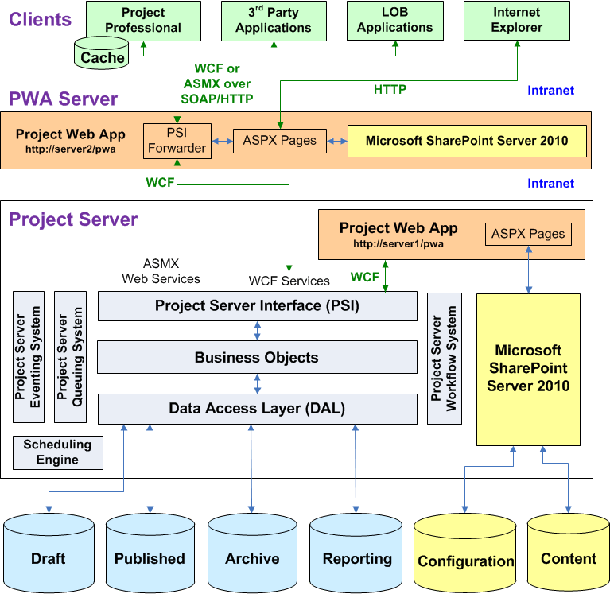
Project Server 2010 Architect
Notes:
Project Server 2010 requires Microsoft SharePoint Server 2010 to be installed on the computer running Project Server and on all Project Web App servers within a SharePoint farm.
The PSI includes both the Windows Communication Foundation (WCF) interface and the ASMX interface for Web services.
The Project Server workflow platform is integrated in the PSI, business object layer, and DAL, and built on Windows Workflow Foundation (WF) in the SharePoint platform.
Project Server task, assignment, and assignment status data is integrated with Microsoft Exchange Server, instead of with a Microsoft Outlook add-in.
Workflow is part of SharePoint/Project Server 2010

Slide 20
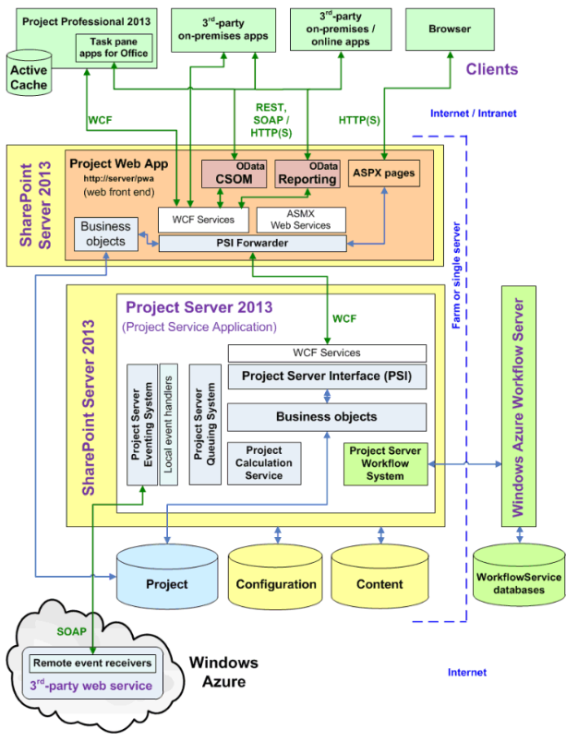
Project Server 2013 Architecture
Notes:
ProjectWebApp database now contains all 4 project database
Project and SdharePoint Database are separated
Workflow is not integrated into 2013… Workflow service server is required

Slide 21
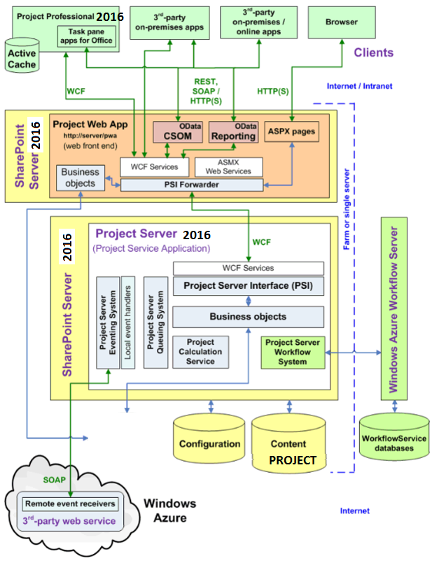
Project Server 2016 Architecture (unofficial)
Notes:
Project Sever 2010
SQL Server 2008 and up
PWA
SharePoint 2010

Slide 22
Upgrade Path #1 for PS2016 to PS2019
2nd
Final
PRODUCTION
SharePoint/ PWA 2016
SharePoint/ PWA 2016
UAT
(User Acceptance Testing)
1st
3rd…n
SharePoint/ PWA 2019

Slide 23
Upgrade Path #2 for PS2016 to PS2019
SharePoint/ PWA 2019
PRODUCTION
SharePoint/ PWA 2016
2nd
UAT
SharePoint/ PWA 2019
1st

Slide 24
Upgrade Path #3 for PS2013 to PS2019
PRODUCTION
3rd
Final
SharePoint/ PWA 2013
SharePoint/ PWA 2019
1st
^{n..m}
UAT
SharePoint/ PWA 2016
SharePoint/ PWA 2019
2nd
m…n
Temp Staging

Slide 25
Upgrade Path #4 for PS2013 to PS2019 non-compliant 2010 version
PRODUCTION
SharePoint/ PWA 2013
SharePoint/ PWA 2019
UAT
Stage PWA 2013
Project Server 2016
SharePoint/ PWA 2019
Temp Staging
Temp Staging

Slide 26
Upgrade Path #5 for PS20xx to PS2016
PRODUCTION
SharePoint/ PWA 20xx
SharePoint/ PWA 2019
UAT
Stage PWA 2003
Stage PWA 2007
Stage PWA 2010
Stage PWA 2013
Stage
PWA
2016
SharePoint/ PWA 2019
Temp Staging
Temp Staging

Slide 27

Building

Slide 28

Major Steps to SharePoint Upgrade
Create SharePoint 2019 Farm Servers
Create SQL Server Scripts
  Backups SQL Server 2016 databases
  Restore on 2019 BAK file SQL Sever
  Security Setup
Create PowerShell Scripts
  Time each PowerShell command (measure-command)
  Log all output
  Make Notes
Create Notes for Un-Scriptable
  Detail Check List for Manual updates
Notes:
Number and Script all steps
Project 2010 had little PowerShell scripting
Project 2007 and before had none.
Stages
Pre-Upgrade / Upgrade / Post-Upgrade
PowerShell Scripting
Timing
Logging
SQL Scripting
Notes
SQL Server Scripting
Backups / Restores
Setting Security
Check List
Manual updates

Slide 29
Architect and Setup SharePoint Farm
Setup Servers
  Azure VM or Premise
  Build Physical Server Environments
  UAT and PRODUCTION
Install SharePoint Software each environment
  AutoSPInstaller
Configure SharePoint Farm Service
  Minimum servers (FE/Cache/APP/Search/SQL)
  Minimum services
Install Office Online Server *
Install Workflow Manager Server *
Install SQL Server Reporting Service (Native Mode)
Notes:
Servers
Azure VM or Premise
Build Physical Server Environments
UAT and PRODUCTION
Install SharePoint Software each environment
AutoSPInstaller (was my preference)
Configure SharePoint Farm Service
Minimum servers (FE/Cache/APP/Search/SQL)
Minimum services
Install Office Online Server *
Install Workflow Manager Server *
Install SQL Server Reporting Service (Native Mode)

Slide 30
Upgrade SharePoint Farm Services
Configure SharePoint Farm Service
  Minimum servers (FE/Cache/APP/Search/SQL)
  Minimum services
Upgrade Service order
  Managed Metadata Service
  User Profile Service
  Secure Store Service
  Business Connectivity Service
  Search Service
  Content Databases
Install Office Online Service *
Install Workflow Manager Service *
Install SQL Server Reporting Service (Native Mode)
Notes:
Servers
Azure VM or Premise
Build Physical Server Environments
UAT and PRODUCTION
Install SharePoint Software each environment
AutoSPInstaller (was my preference)
Configure SharePoint Farm Service
Minimum servers (FE/Cache/APP/Search/SQL)
Minimum services
Install Office Online Server *
Install Workflow Manager Server *
Install SQL Server Reporting Service (Native Mode)

Slide 31
Create SQL or PowerShell Scripts
Pre Upgrade Steps
  Install SQL Server
  Setup Farm Admin Accounts
SQL Server Scripting
  Backups / Restores
  Security Setup
Notes:
Upgrade Stages
Servers and Joining Domain
Accounts and Permissions
SQL Server Scripting
Backups / Restores
Security Setup
Demo
Restoring with SQL script
Cleanup with SQL script

Slide 32
Build PowerShell Scripts for each step
Stand up SharePoint Central
  SharePoint Configuration Wizard
  PowerShell Script (db naming convention)
Build and Upgrade Services
  As specified in previous slide
Upgrade SharePoint Content
Migration Scripts to 2019
Notes:
Upgrade Stages
Servers and Joining Domain
Accounts and Permissions
SQL Server Scripting
Backups / Restores
Security Setup
Demo
Restoring with SQL script
Cleanup with SQL script

Slide 33
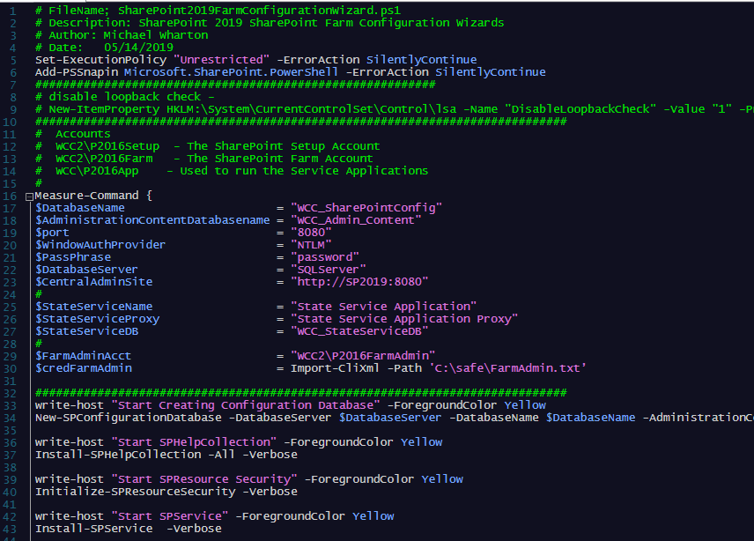
PowerShell Script SharePoint Wizard

Slide 34
1st upgrade is about Discovery
I hear this all the time!
Our SharePoint Farm is Out-of-box
  Yea… Right!
Our Project Server is Out-of-Box
  Yea.. Right Again!!!
  Every upgrade has run into different issues!
  Don’t be afraid to call Microsoft for support.
Notes:
Many SharePoint farms are several years old.
Installation of web parts
Experimenting on production
That may have been intention but over the years different people, consultants, trainers, patches have changed it

Slide 35
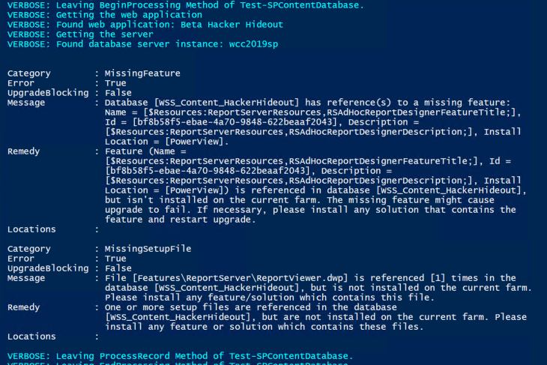
TEST-SPContentDatabase Results
Notes:
Many SharePoint farms are several years old.
Installation of web parts
Experimenting on production
That may have been intention but over the years different people, consultants, trainers, patches have changed it

Slide 36
What you might find after upgrade
3rd Party Web Parts don’t migrate
Project Site Templates
Customized Navigation
PWA workflow missing
Changing Domains
Old resources and projects schedules
SharePoint Permissions
Project Permissions
PWA Configuration Changes
Broken Project Sites / Issues and Risks
Notes:
3rd Party Web Parts don’t migrate
Project Site Templates all out of wack
Customized Navigation doesn’t jive with standard menu
PWA workflow missing – workflow has moved about with each version
Changing Domains
Old resources and projects schedules
SharePoint Permissions
Project Permissions
PWA Configuration Changes
Broken Project Sites / Issues and Risks

Slide 37
SharePoint/Project Server 2010 to 2013
Pre upgrade
Upgrade
  SharePoint Upgrade
    Test-SPContentDatabase
    Mount-SPContentDatabase
    Test-SPSIte
    Upgrade-SPSite
  Project Server Upgrade
    ConvertTo-SPProjectDatabase
    Mount-SPProjectDatabase
    Test-SPProjectDatabase
    Upgrade-SPProjectDatabase
    Mount-SPProjectWebInstance
    Test-SPProjectWebInstance
    Upgrade-SPProjectWebInstance
    Enable-SPFeature
Post Upgrade
Notes:
Pre Upgrade
SharePoint Upgrade
Test-SPContentDatabase
Mount-SPContentDatabase
Test-SPSIte
Upgrade-SPSite
Project Server Upgrade
ConvertTo-SPProjectDatabase
Mount-SPProjectDatabase
Test-SPProjectDatabase
Upgrade-SPProjectDatabase
Mount-SPProjectWebInstance
Test-SPProjectWebInstance
Upgrade-SPProjectWebInstance
Enable-SPFeature
Post Upgrade

Slide 38
SharePoint/Project Server 2013 to 2016
Pre-Upgrade
The Upgrade
  Create Web Application
  SharePoint Upgrade
    Test-SPContentDatabase
    Mount-SPContentDatabase
  Project Server Upgrade
    Migrate-SPProjectDatabase
    Migrate-SPProjectResourcePlans
Post-Upgrade
Notes:
Pre Upgrade
Create Project Server Farm
Copy and Move databases
SharePoint Upgrade
Mount-SPContentDatabase
Test-SPContentDatabase
Project Server Upgrade
Migrate-SPProjectDatabase *** (copy db into Content db)
Migrate-SPProjectResourcePlans
Set-SPProjectDatabaseQuota
Post Upgrade

Slide 39
SharePoint/Project Server 2016 to 2019
Pre-Upgrade
The Upgrade
  Create Web Application
  SharePoint Upgrade
    Test-SPContentDatabase
    Mount-SPContentDatabase
  Project Server Upgrade
    Migrate-SPProjectDatabase
    Migrate-SPProjectResourcePlans
Post-Upgrade
  Dismount -SPContentDatabase
Notes:
Pre Upgrade
Create Project Server Farm
Copy and Move databases
SharePoint Upgrade
Mount-SPContentDatabase
Test-SPContentDatabase
Project Server Upgrade
Migrate-SPProjectDatabase *** (copy db into Content db)
Migrate-SPProjectResourcePlans
Set-SPProjectDatabaseQuota
Post Upgrade

Slide 40

Stabilizing

Slide 41
Stabilizing Period
Upgrade is completed
Build Post Upgrade Checklist
  SharePoint Farm Adjustments
  Rebuild Reports
  Testers
Deploy Project Pro client for select users
TEST, TEST, TEST
UPDATE SCRIPTS AND NOTES
Notes:
Upgrade is completed
Build Post Upgrade Checklist
SharePoint Farm Adjustments
Rebuild Reports
Testers
Deploy Project Pro client for select users
TEST, TEST, TEST
UPDATE SCRIPTS AND NOTES

Slide 42
Stabilizing Period
TEST
TEST
TEST
UPDATE SCRIPTS /NOTES
Notes:
TEST
TEST
TEST
UPDATE SCRIPTS /NOTES

Slide 43

Deployment

Slide 44
Deployment Period
Execute Pre-Upgrade Check List
  Coordinate Deploy Project Pro client
  Check in objects (Projects/Resources, etc)
  Lock Sites / Project Database Read Only
Execute Upgrade Scripts
  Backup and Restore SQL Databases
  PowerShell Upgrade Scripts
Execute Post-Upgrade Check List
Stabilize Again
  SharePoint Farm Adjustments
  Rebuild Reports
  PMO Tester
Upgrade Accepted and Approved
Notes:
Project2010
Project Sever 2010
SQL Server 2008 and up
PWA
SharePoint 2010

Slide 45
Links
MyProjectExpert
  http://MyProjectExpert.com
GitHub
  https://github.com/MyProjectExpert/ProjectServerTools
AutoSPInstallerOnine
  https://autospinstaller.com/
Microsoft Documentation
  https://docs.microsoft.com/en-us/project/install-and-configure-project-server-2016

Slide 46


Slide 47
About: Michael Wharton (SharePoint/PMO Consultant)
30+ EPM Deployments 20+ SharePoint Migrations 1000+ Trained Project Manager
PMO Automations and Monitoring
Fundamentals of Scheduling
Microsoft
MVP | MCT | MCTS | MCP+44
Technical Reviewer
Missing Manual: Project 2010 and Project 2013
Project Management using MS Project 2013
Forecast Scheduling 2013
Forecast Scheduling 2018
Forecast Program
7x
Wharton Computer Consulting since 1997
Comic Books
Hardware
Hacking
Robots
Walking
PowerShell
Field Notes
MyProjectExpert.com
Notes:
My passion real passion is automating and monitoring Project Server
My second passion is maintaining good Field Notes!! Using PowerShell
Field Notes
Windows
SQL Server
SharePoint
Project Server
Consistency with Deployments.

